Slide 1

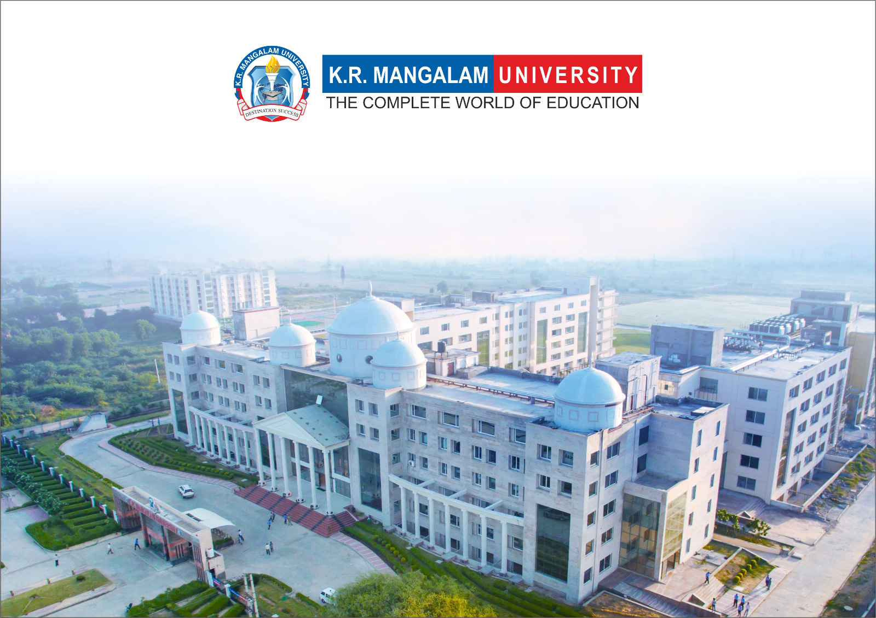
Course Code: ETCCCH104
Course Name: Engineering Chemistry
Program: B.Tech
Dr Deepak Yadav
Assistant Professor, Department of Chemistry
School of Basic and Applied Sciences
K.R. Mangalam University
Sohna Road, Gurugram

Slide 2
Preparation and application of some industrially important polymers (Natural rubber, Buna S, Buna-N

Slide 3
Session Outcomes
Define and describe the structure of Natural Rubber, Buna-S, and Buna-N.
Explain the preparation methods of these polymers.
Identify the physical and chemical properties.
Recognize the industrial and commercial applications.
Differentiate between natural and synthetic rubbers.

Slide 4
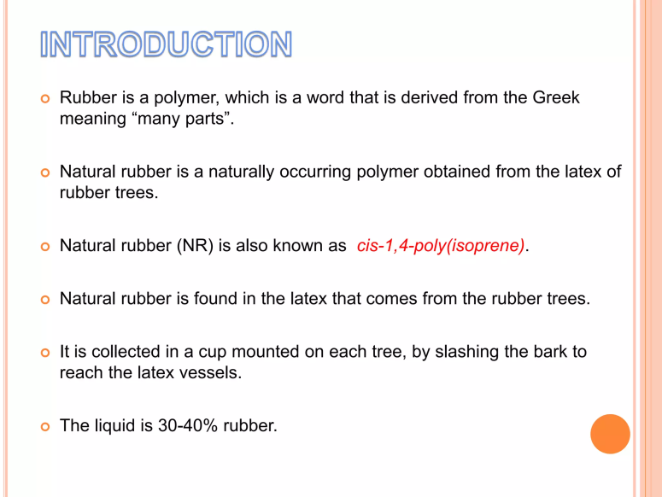
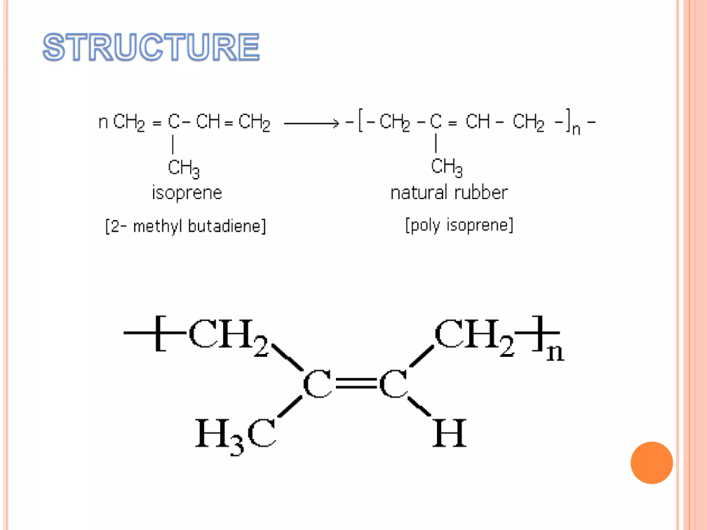
1. Natural Rubber

Slide 5
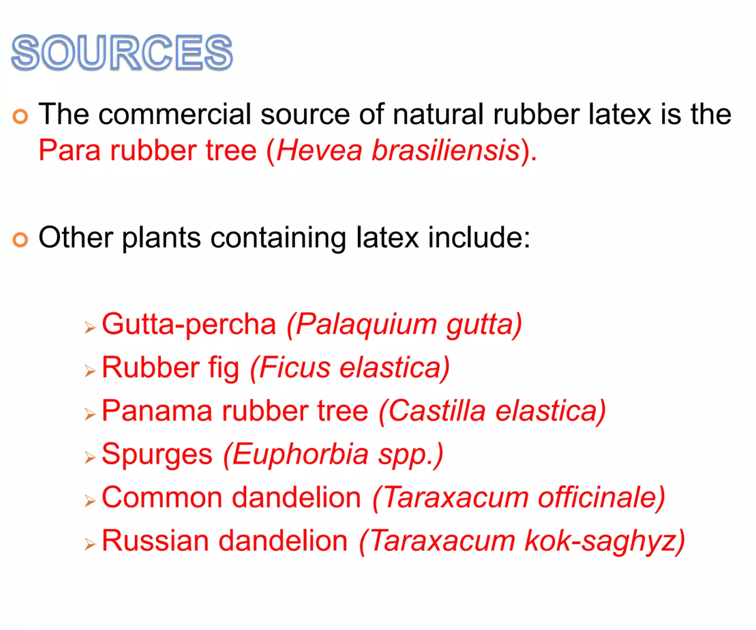

Slide 6
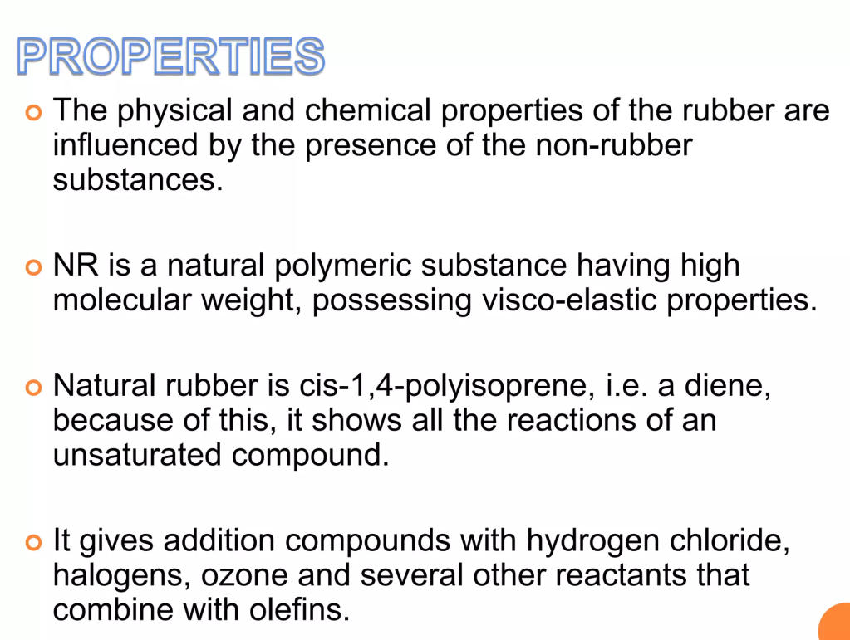
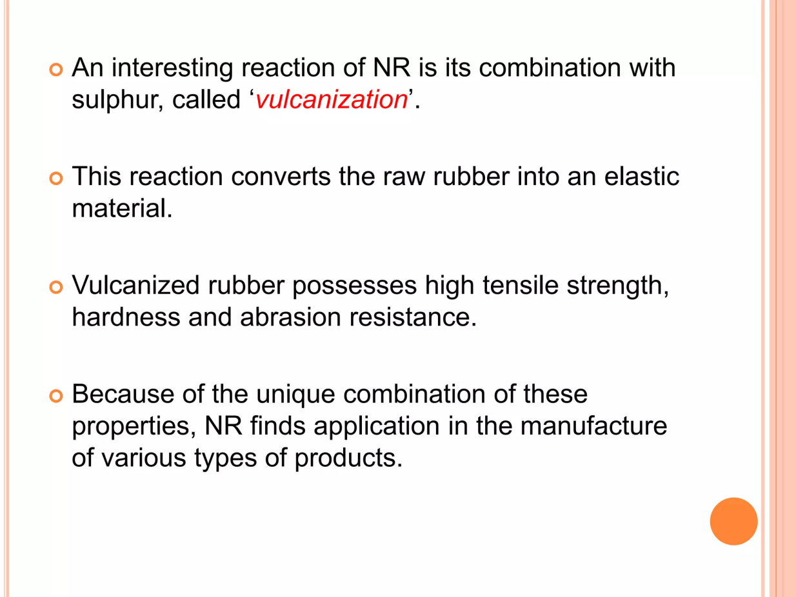

Slide 7
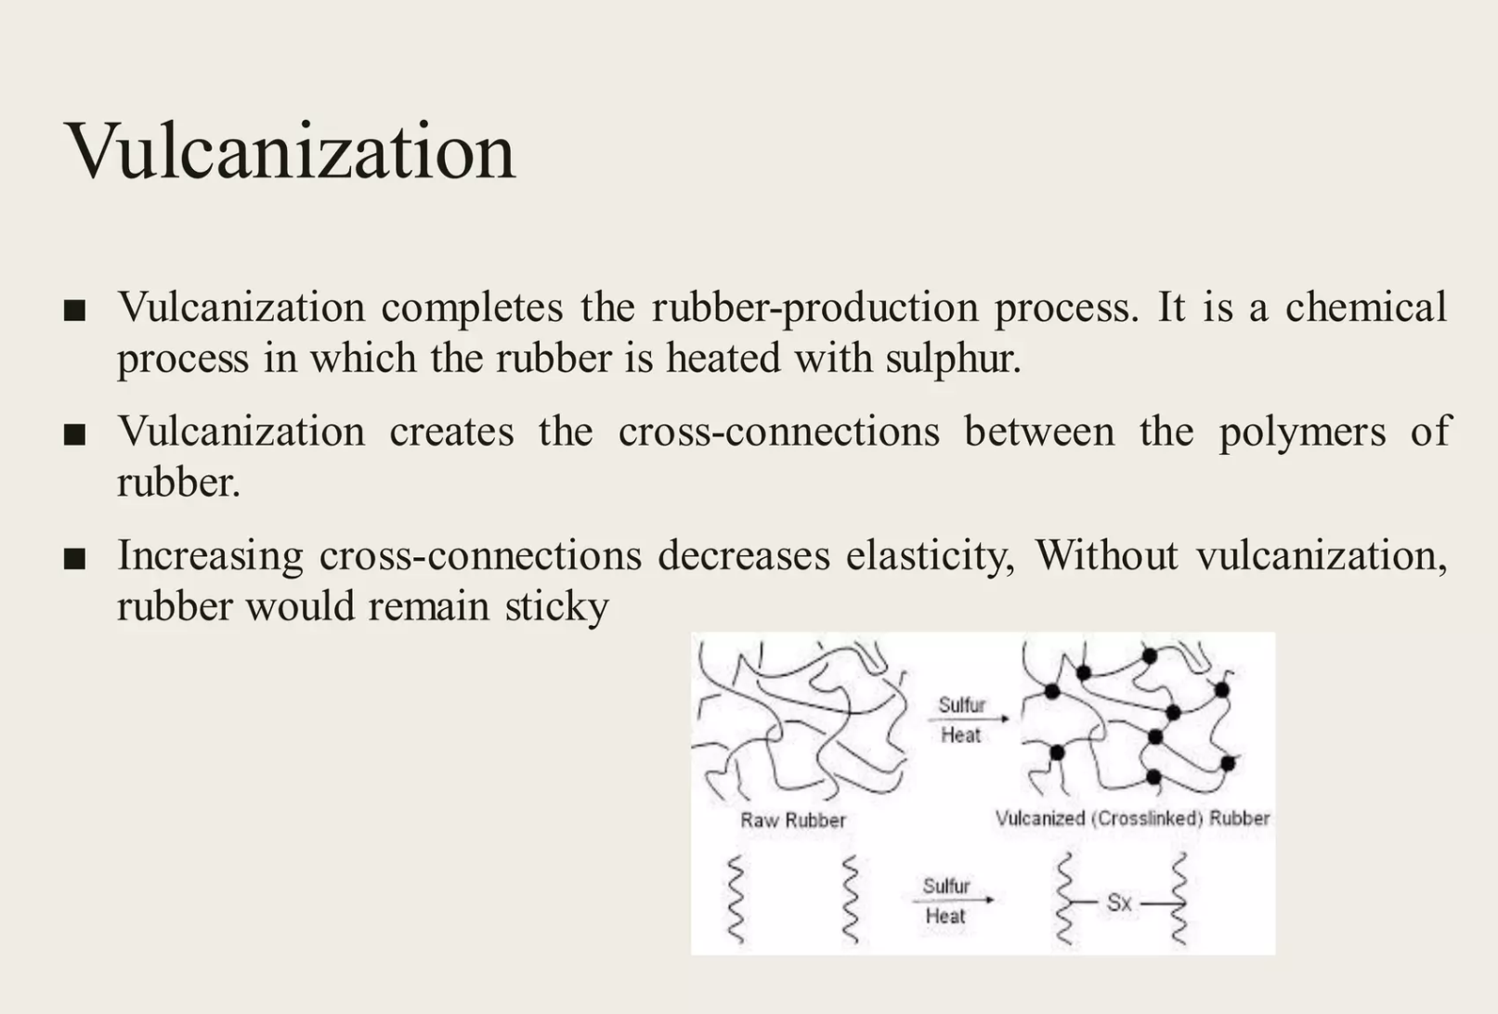

Slide 8
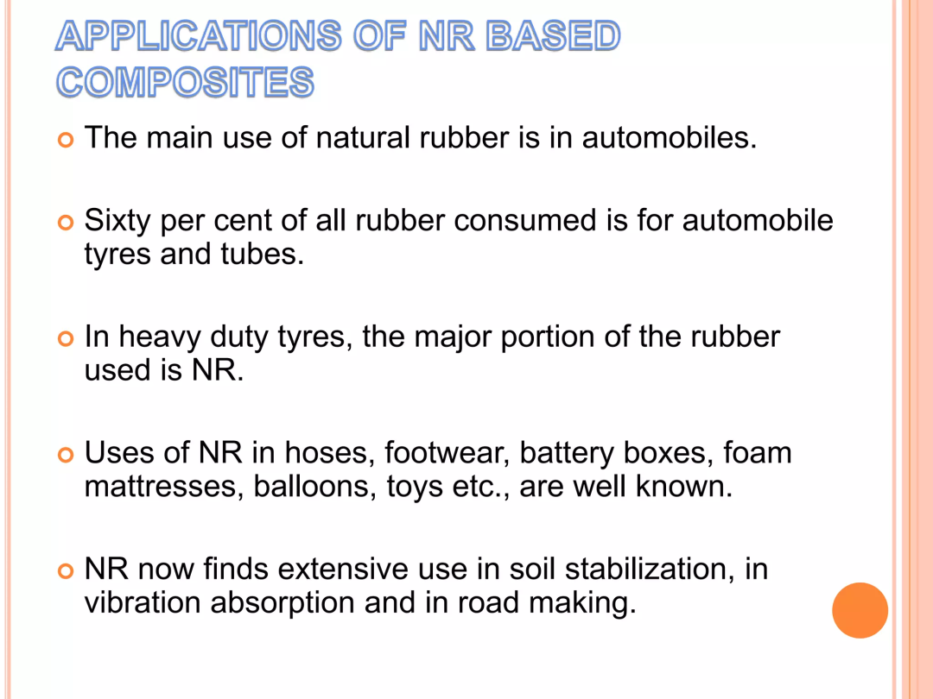
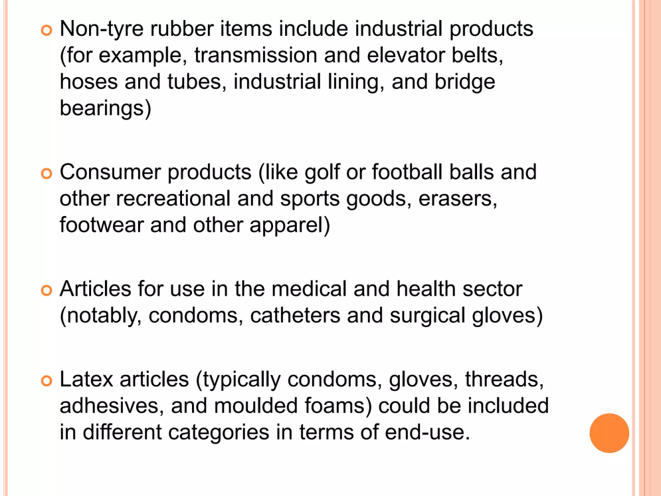

Slide 9
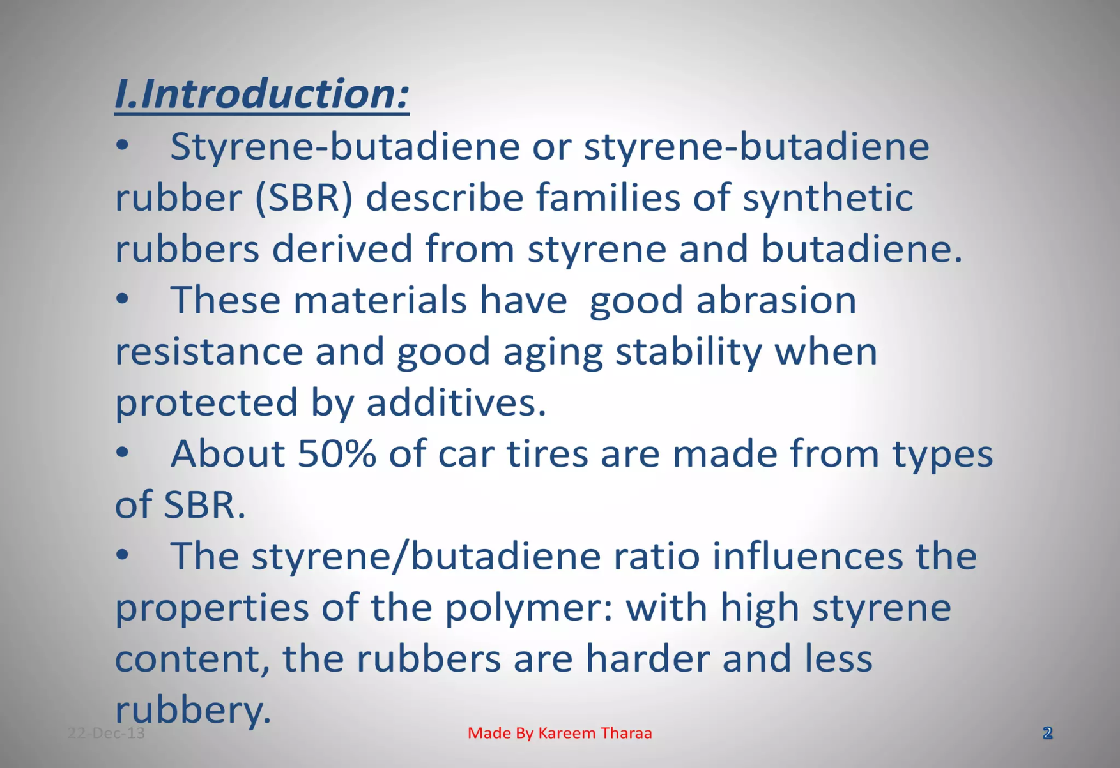
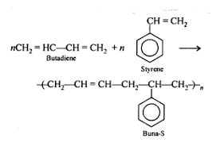
2. BUNA-S

Slide 10
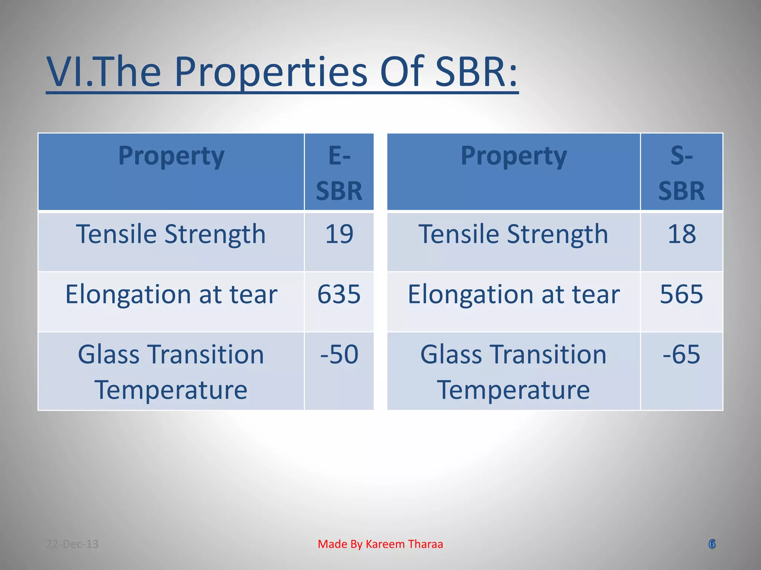

Slide 11
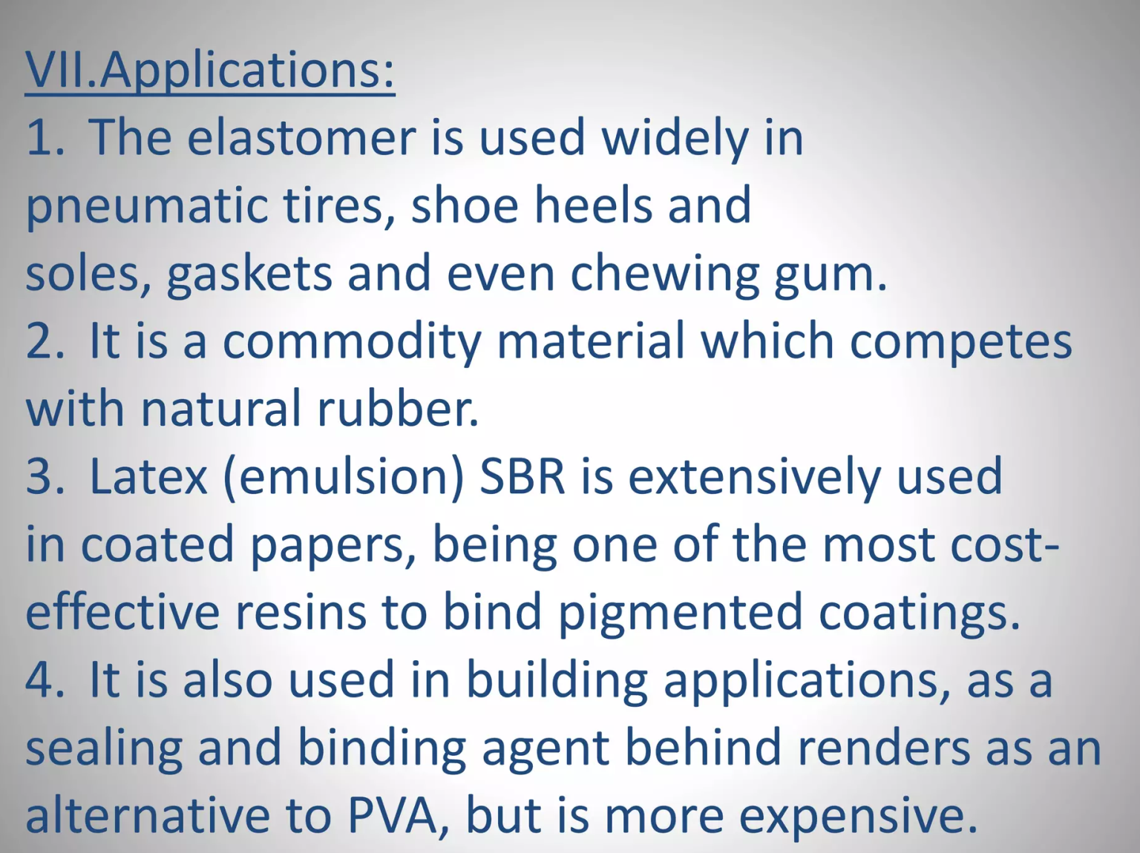

Slide 12
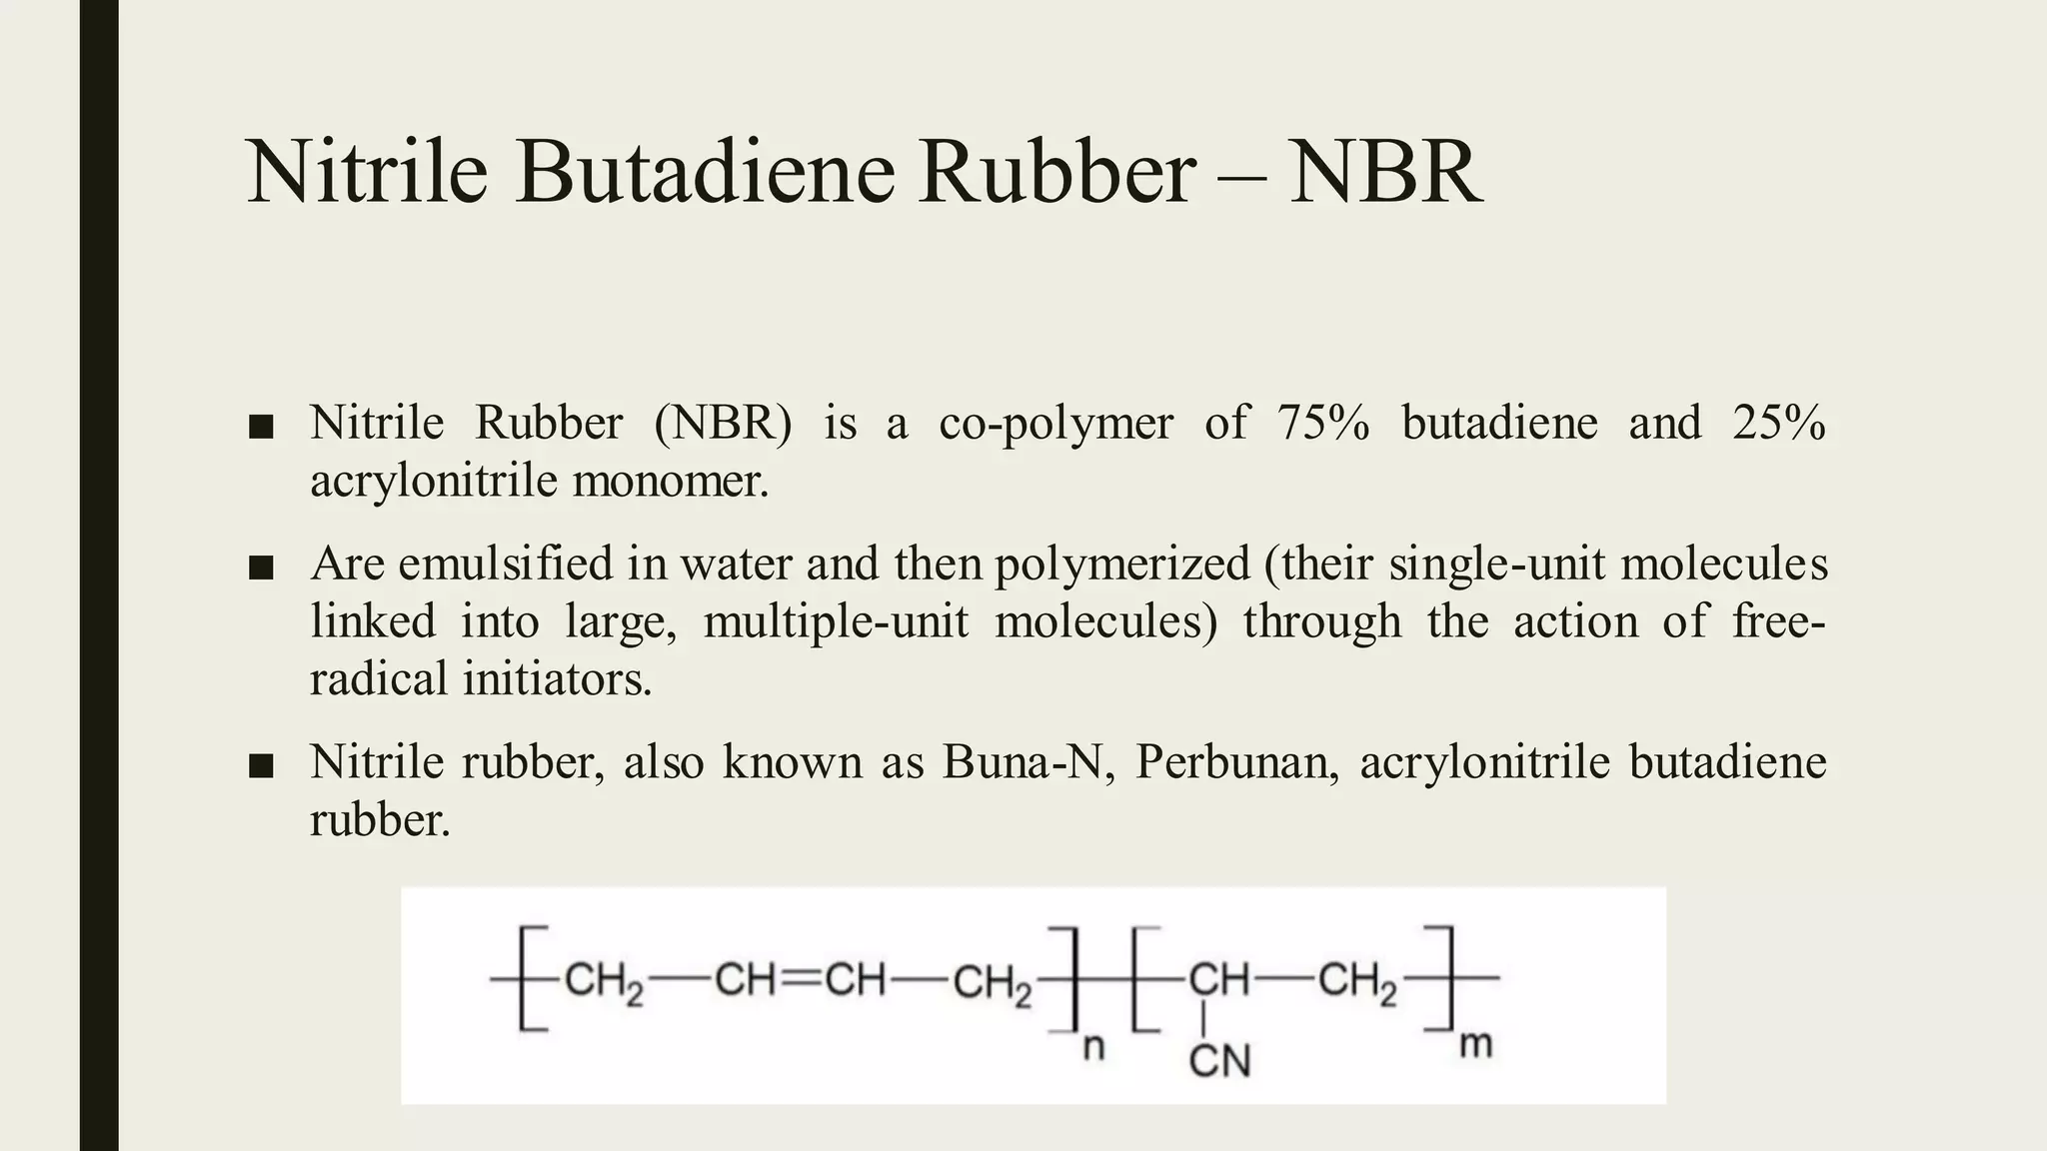
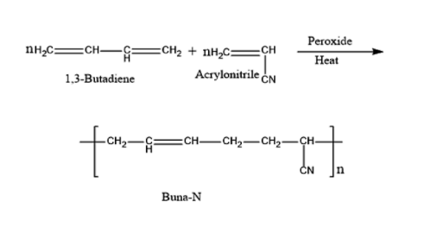
3. BUNA-N

Slide 13
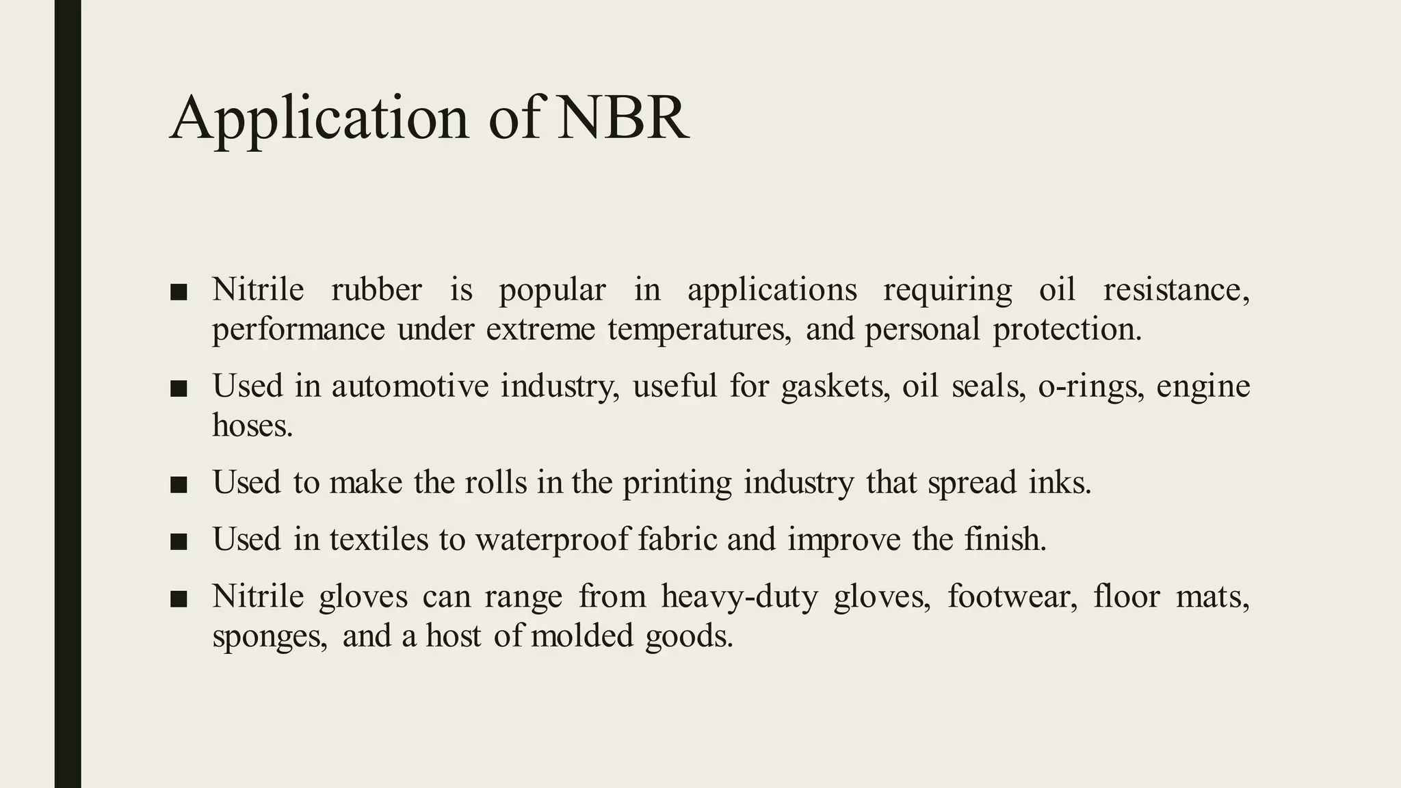

Slide 14
Comparison
Polymer | Monomers Used | Key Property | Applications
Natural Rubber | Isoprene | Elastic, soft, weak in oils | Tyres, footwear
Buna-S | Butadiene + Styrene | Abrasion resistant, durable | Tyres, belts
Buna-N | Butadiene + Acrylonitrile | Oil & chemical resistant | Seals, hoses

Slide 15
Takeaway of Session
Natural Rubber: cis-polyisoprene, elastic, vulcanization improves strength.
Buna-S: synthetic rubber, widely used in tyres, abrasion resistant.
Buna-N: nitrile rubber, resistant to oils and fuels, used in seals & hoses.
Synthetic rubbers overcome limitations of natural rubber.

Slide 16
Thank You

